Slide 1

Group Chat

Slide 2
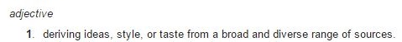
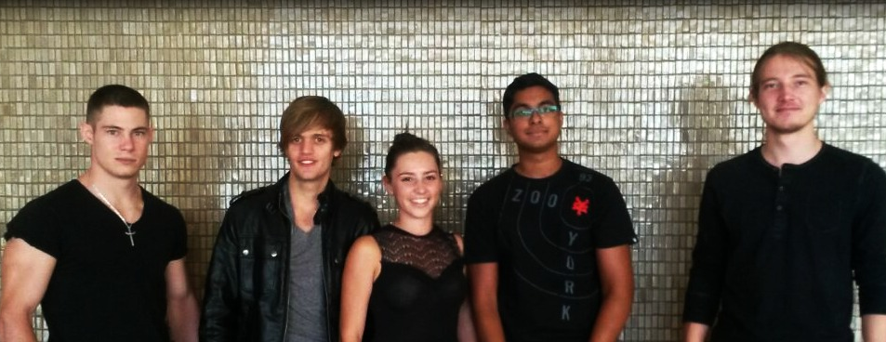
Team Eclectic

Slide 3
Existing System Overview
Voice Calls
Video Calls
Private Chat Messaging
No Group Chat Messaging

Slide 4
Requirements
Group Chat Functionality
Creation & Deletion
Member Addition & Removal
Message Broadcasting
AES256 Encrypted & Unencrypted Messaging
UI Improvements
Waterfall

Slide 5
User interface
Research for User Interface – third party perspective
Interface Consistency
Separation of Individual and Group Chats
Usability Testing

Slide 6
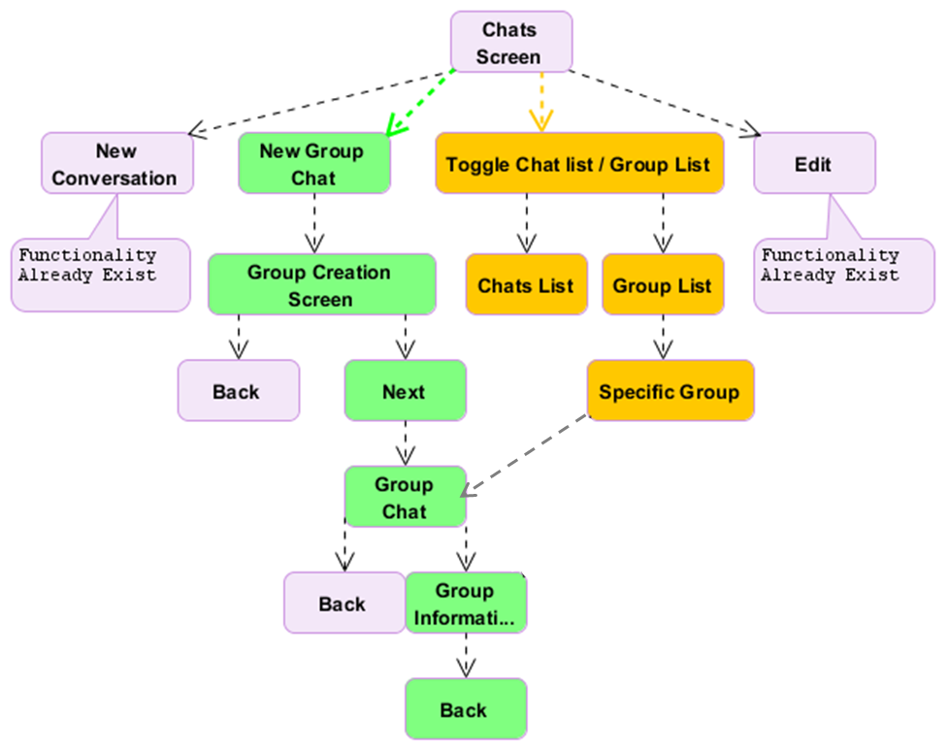
System Flow

Slide 7
Design
Message Listener
Linphone Manager
Encryption
Group Chat
Group Chat Manager
Storage
Group Chat
Group Chat
Notes:
Our listener listens for new messages and depending on the message headers, delegates the handling of the message to the Linphone Manager of the Group Chat Manager.
Depends on existence of a Group Chat ID header.
Group Chat Manager delegates the message to the correct group, if it exists.
Group Chat handles the message appropriately, possibly first decrypting the message.
If a plain text message, it is stored.
Other message types include group updates such as for member changes, or admin changes.

Slide 8
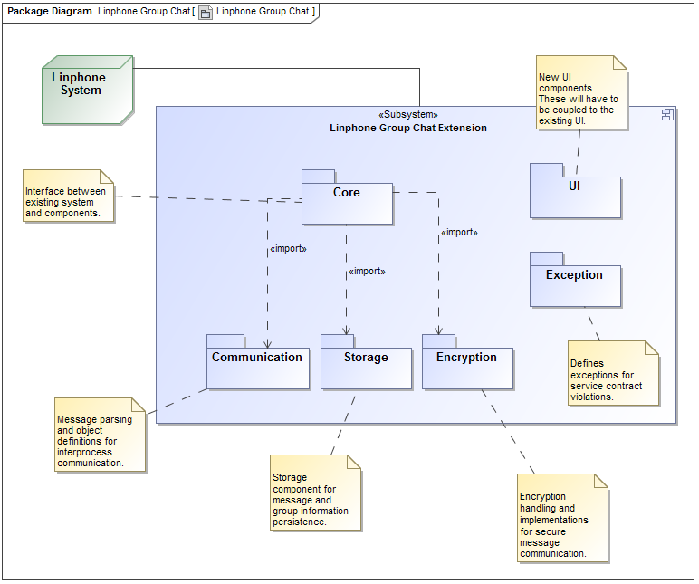
Design
Component-based Design
Patterns
Strategy
Singleton
Factory
Extensibility
Additional Encryption Algorithms
Additional Messaging Strategies
Alternative Storage Mechanisms
Notes:
Separation of concerns.
Allowing different implementations of certain aspects to be interchanged through use of interfaces.
Patters:
Strategy used for message sending based on whether or not encryption is used.
Factory to produce the correct messaging strategy based on encryption type, also for providing the correct storage mechanism.
Singleton used for Listener, Manager and Storage.

Slide 9
Design
Notes:
Separation of concerns.
Allowing different implementations of certain aspects to be interchanged through use of interfaces.
Patters:
Strategy used for message sending based on whether or not encryption is used.
Factory to produce the correct messaging strategy based on encryption type, also for providing the correct storage mechanism.
Singleton used for Listener, Manager and Storage.

Slide 10
Encryption
RSA Encryption
Secret Key Exchange
AES 256 Encryption
Normal Messaging
Administrative Tasks
Notes:
RSA for secure channel upon member invite.
AES secret key is sent through this channel.
AES used for normal communication thereafter.

Slide 11

Questions

